Slide 1
AI Powered Learning Assistant
Trident Academy of Technology
Guided By:- Dr. Sumati Baral
Presented By:- Group 11

Slide 2
Project Statement & Motivation
AI-powered learning assistant
Instant doubt solving system
Personalized study recommendations
Adaptive quizzes for practice
Learn anytime, anywhere
Problem:
Motivation:
24/7 AI-based learning support
Instant doubt resolution
Personalized learning experience
Interactive & engaging system
Better performance tracking

Slide 3
Objectives
Personalized learning
Instant doubt solving
Adaptive quizzes
Performance tracking
Flexible learning

Slide 4
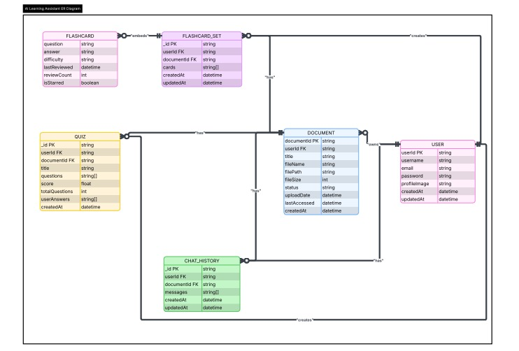
Project Functionalities & Features

Slide 5
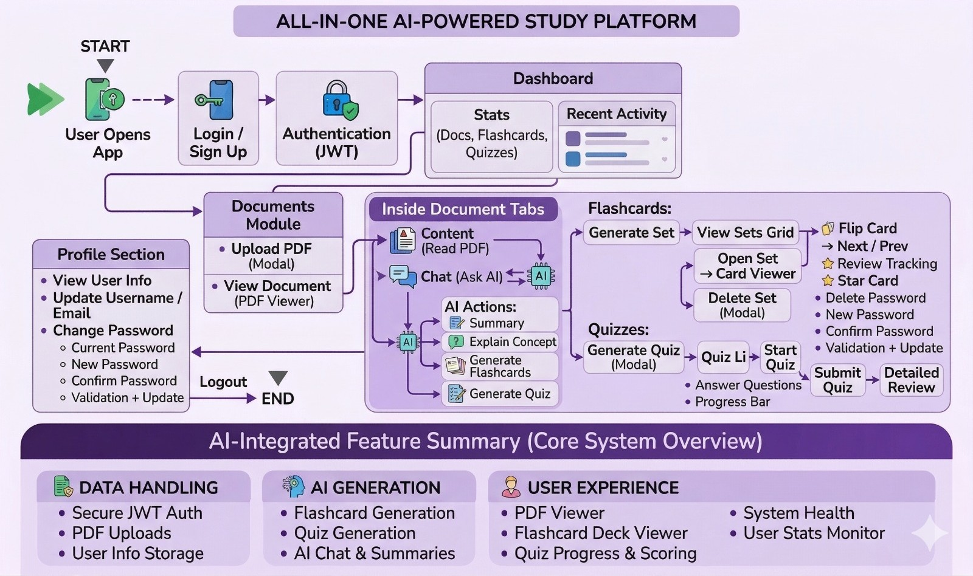

Slide 6
Methodologies
Collect user input (questions & preferences)
Process data using AI (NLP techniques)
Generate responses using AI models
Develop system (frontend + backend + database)
Test and improve system performance

Slide 7
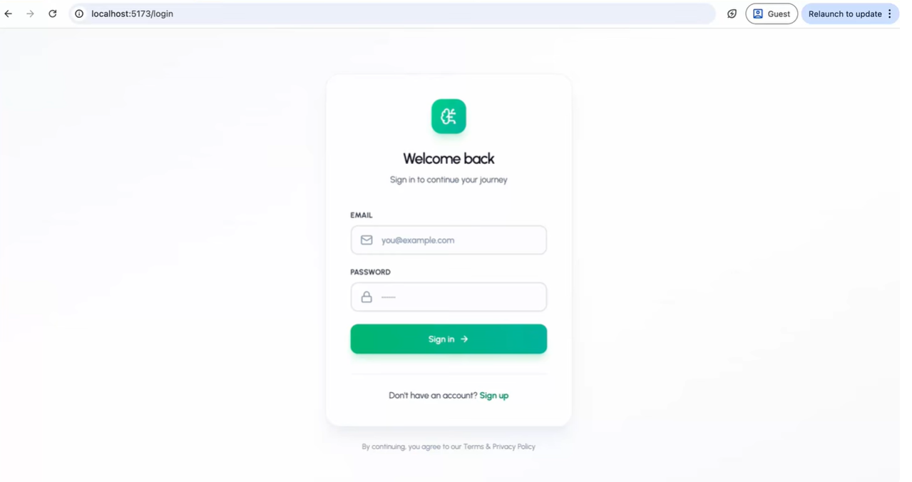
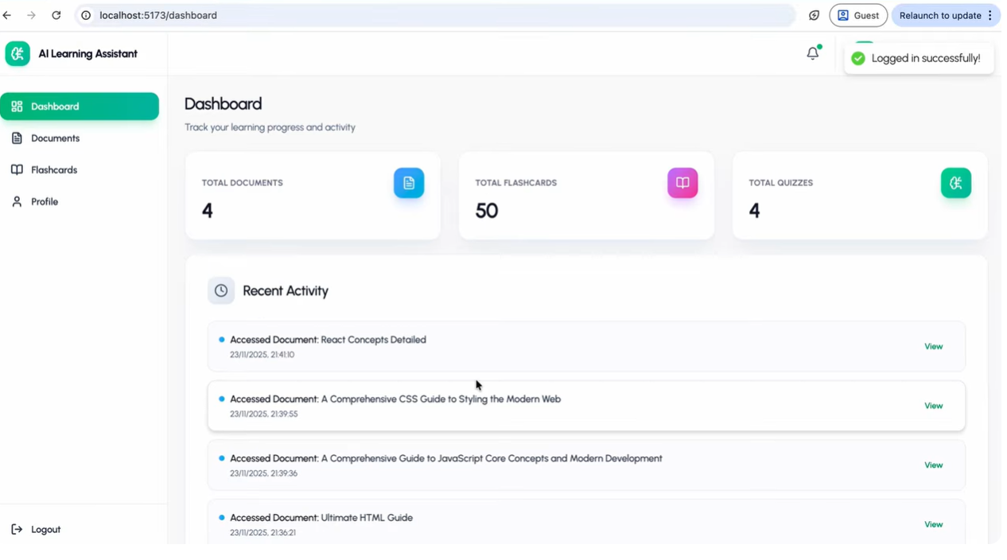
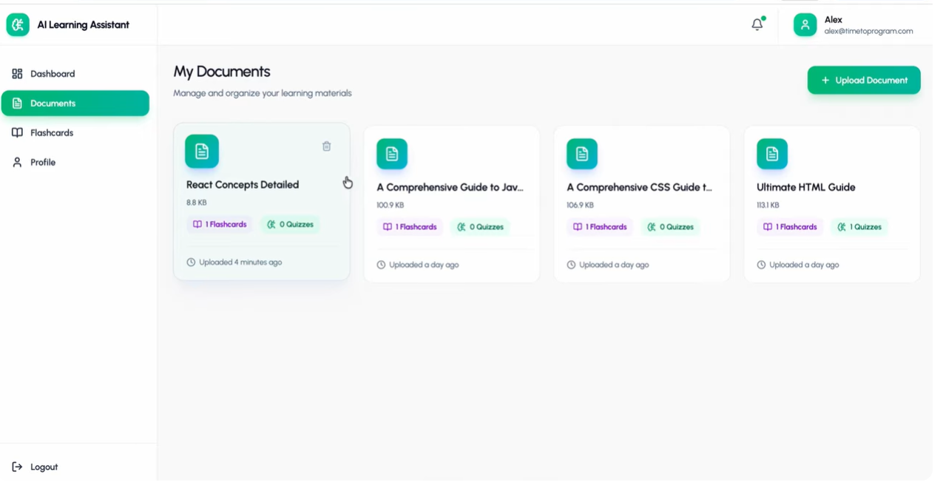
Result

Slide 8
Conclusion
AI improves modern learning methods
Provides personalized learning experience
Enables instant doubt solving
Supports learning anytime, anywhere
Enhances overall student performance

Slide 9
Thank You

